Slide 1

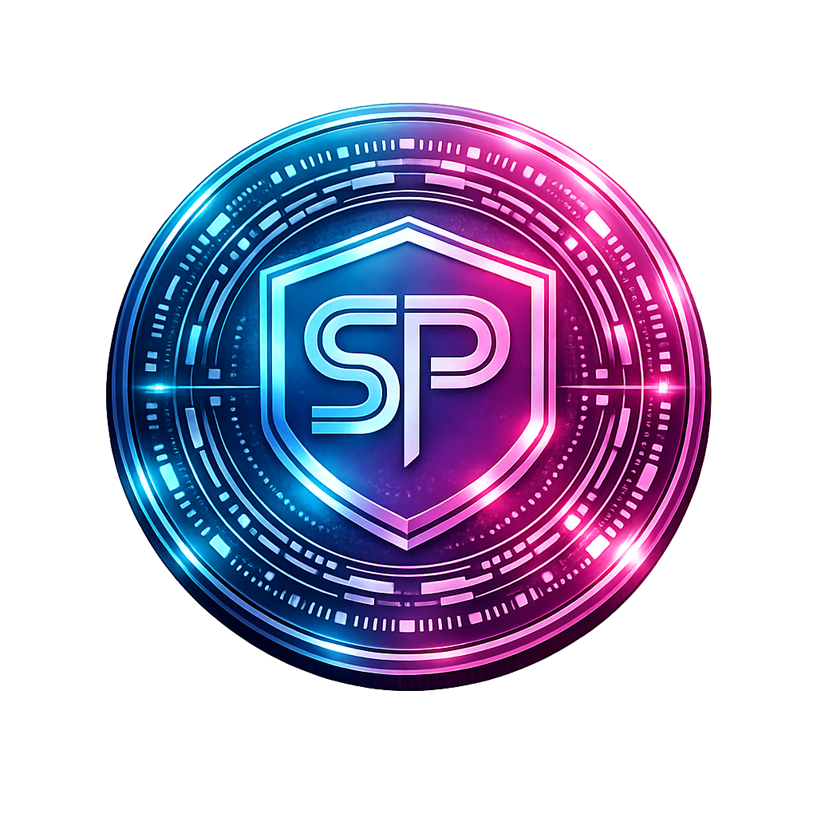
Solus Protocol The Standard for Decentralized Medical Data Integrity
Secure, Patient-Controlled Healthcare Records on XRPL

Slide 2

About US
Our Background
Experienced in blockchain development and healthcare data challenges. Passionate about fixing fragmented medical records through decentralized, patient-first solutions on XRP Ledger (XRPL).
Our Mission
Building the decentralized backbone for secure, interoperable medical data integrity—empowering patients with true ownership while enabling trusted access for providers.
Why South Carolina?
Headquartered in Mount Pleasant, SC. Prioritizing local pilots with MUSC, clinics, and medical facilities to drive healthcare innovation and economic impact in-state first.
Current Stage
Solo-founder led, highly coachable team focused on real-world utility. Actively seeking advisors, partners, and resources (e.g., SCRA network) to scale the protocol, complete integrations (Axelar bridge), and onboard clinical pilots.
Core Values
Security First
Patient Sovereignty
Transparent & Long-Term Building
Real Utility Over Hype

Slide 3
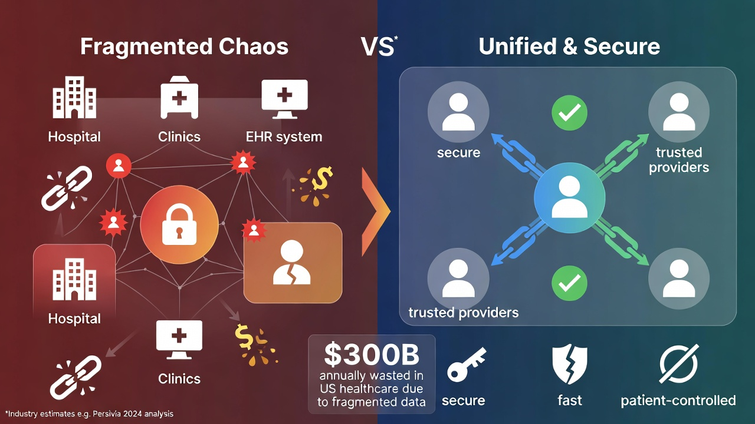
Problem
Healthcare data is fragmented, insecure, and lacks true patient control.
Key Pains:
Siloed records across providers → medical errors, care delays, redundant tests
Privacy breaches & rising cyber threats
No patient ownership or easy interoperability
Compliance challenges (e.g., HIPAA)
US-Wide Impact:
Fragmented / "dirty" data costs the US healthcare system ~$300 billion annually — about 14% of total industry expenses from mismanagement, redundancies, and inefficiencies (industry estimates, 2024–2025 analyses).
South Carolina Relevance:
These issues hit regional networks hard, where siloed data hinders coordination in systems serving millions (e.g., MUSC reaches 2.4M patients statewide). Leads to worse outcomes, higher local costs, and barriers to personalized care in SC communities.

Slide 4
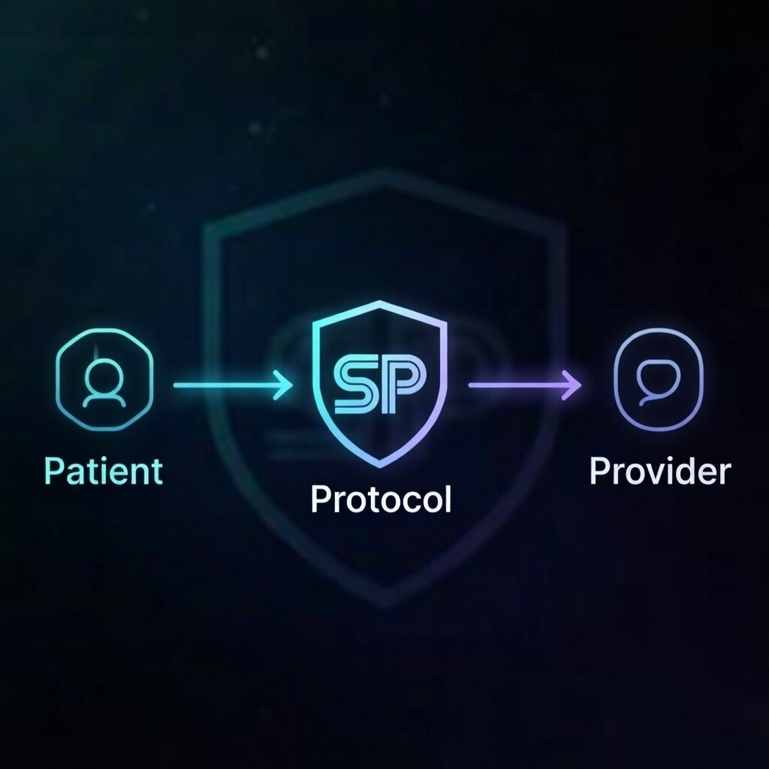
Solution
Solus Protocol:
Decentralized blockchain protocol on XRP Ledger (XRPL) for tamper-proof, patient-sovereign medical data
Enables secure storage, privacy-preserving sharing, verifiable integrity
Patient controls access; Providers get seamless, compliant (HIPAA-aligned) interoperability
Enterprise SDKs for easy integration

Slide 5
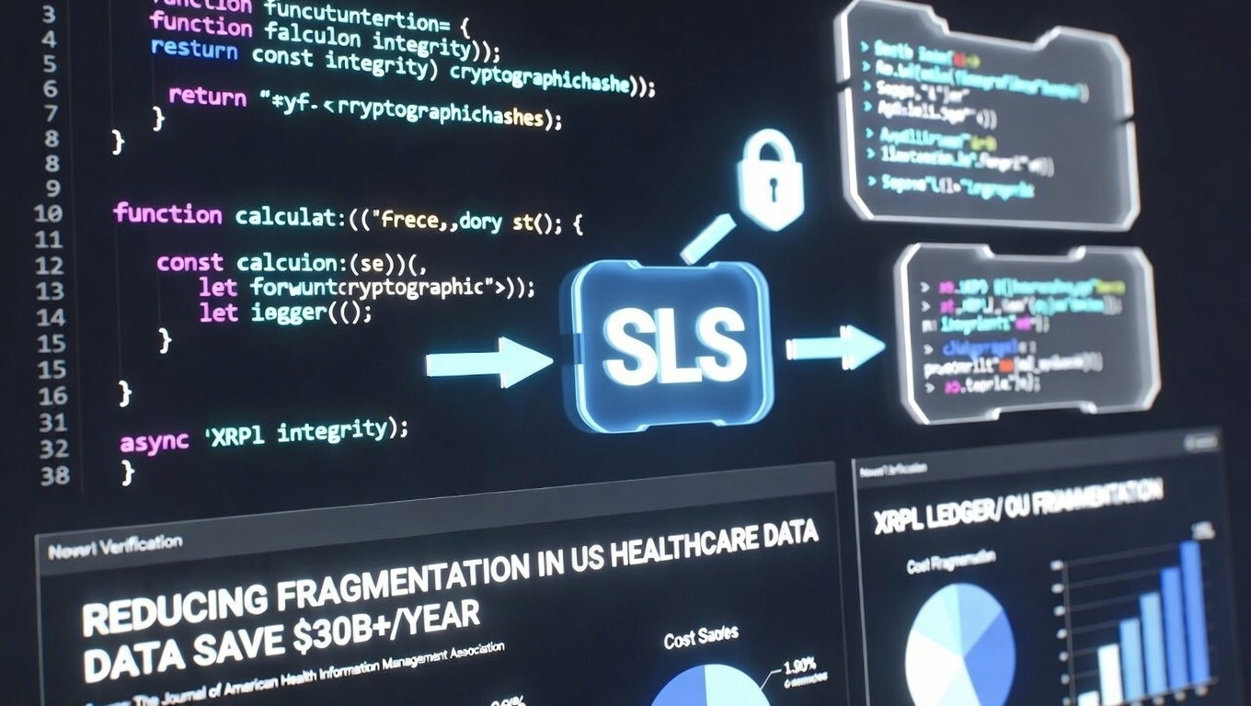
Product & technology
Current Status:
Working protocol on XRPL with token ($SLS), treasury security (locks), bridging (Axelar integration in progress)
Key Features:
Immutable records, patient permissions,
anti-tamper, scalability via XRPL
Defensibility:
Novel Protocol Design + Open-Source (Apache 2.0) for Adoption + Future Proprietary Layers

Slide 6
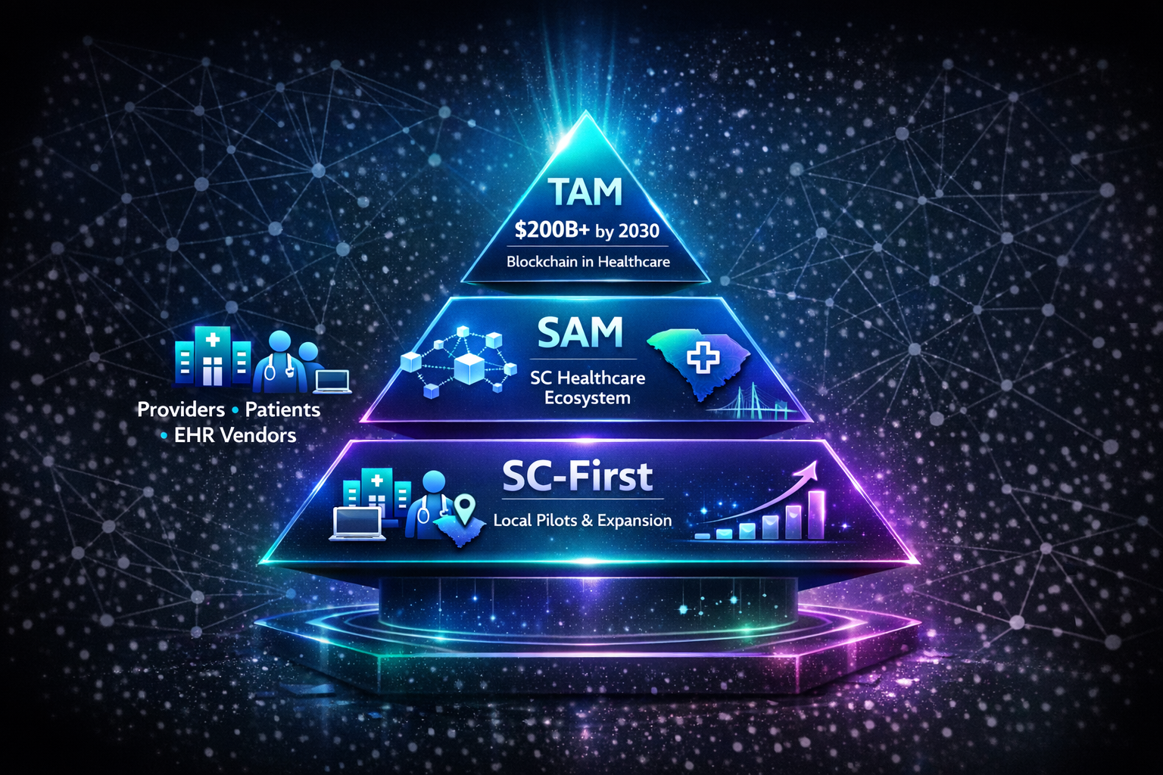
Market opportunity
Who Uses It:
Healthcare providers (MUSC, SC clinics/hospitals), patients, EHR vendors
Total Addressable Market:
Blockchain in healthcare ~$11B (2024) → $200B+ by 2030 (CAGR 60%+)
Serviceable Addressable Market:
SC healthcare ecosystem (MUSC serves 2.4M patients; state digital health push)
SC-First:
Pilots with local facilities → national expansion

Slide 7
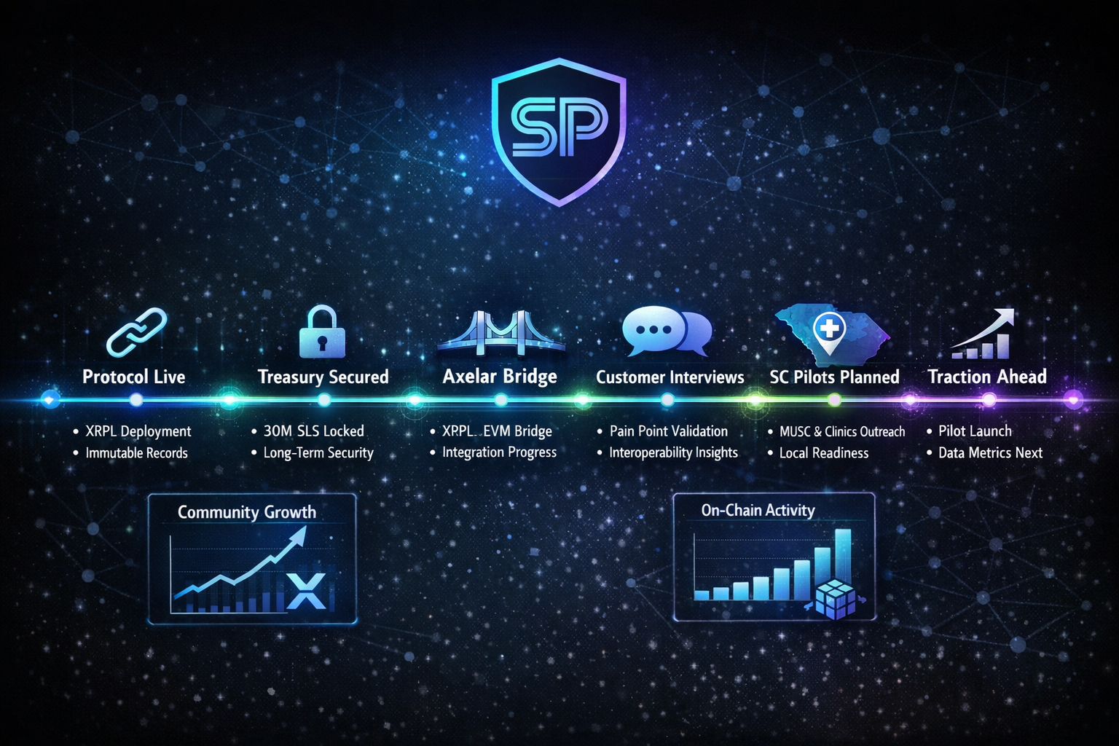
Traction & Validation

Slide 8
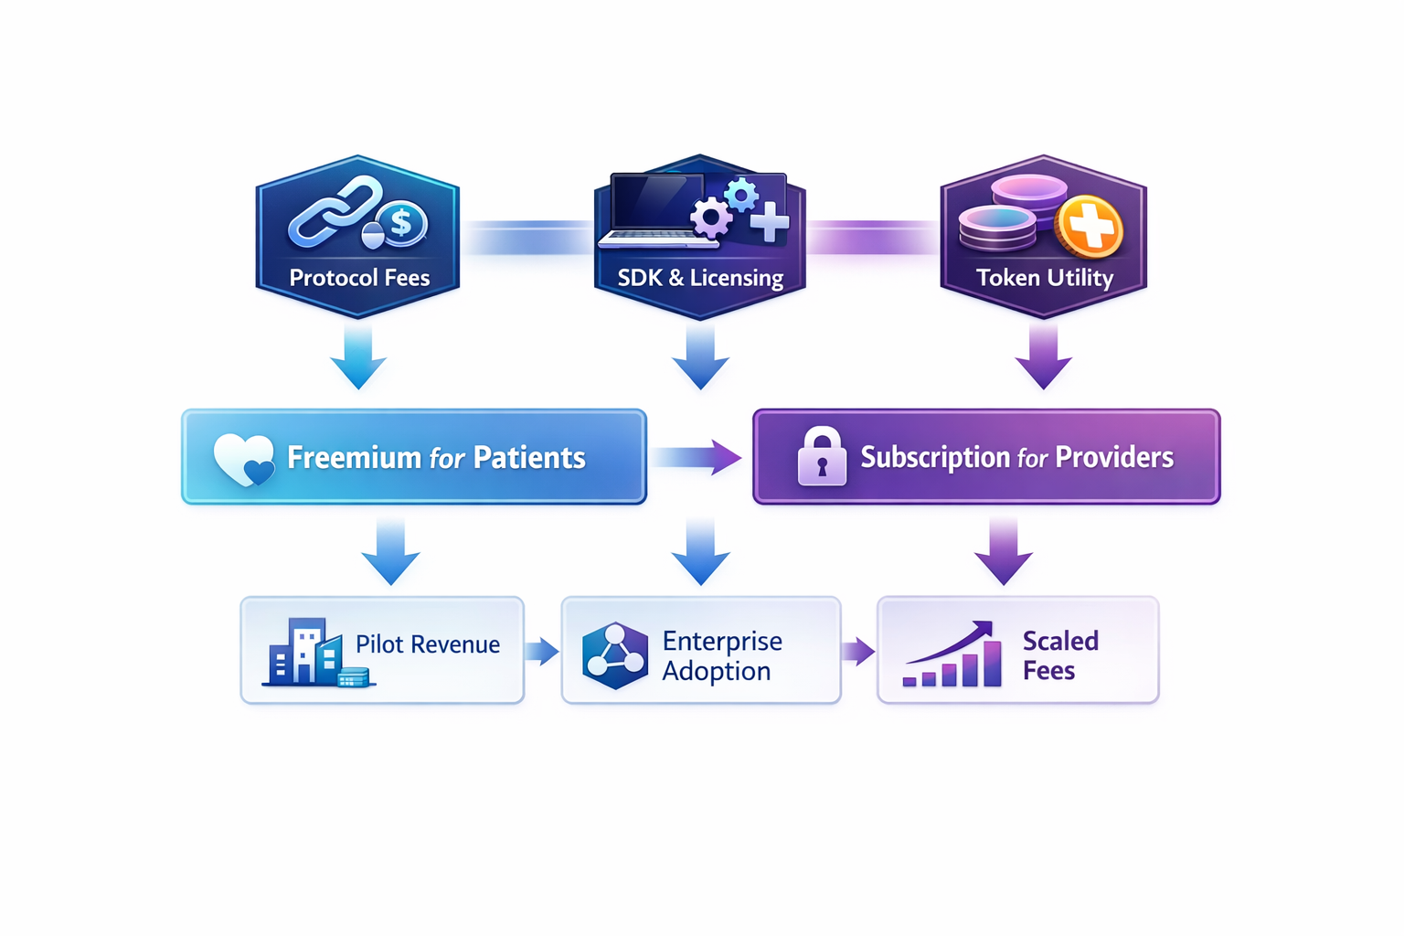
Business model
Revenue Paths: Protocol fees, SDK/enterprise licensing, token utility (incentives)
Pricing Strategy: Freemium for patients, subscription for providers
Path to Profitability: Pilot revenue → Enterprise Adoption → Scaled Fees

Slide 9
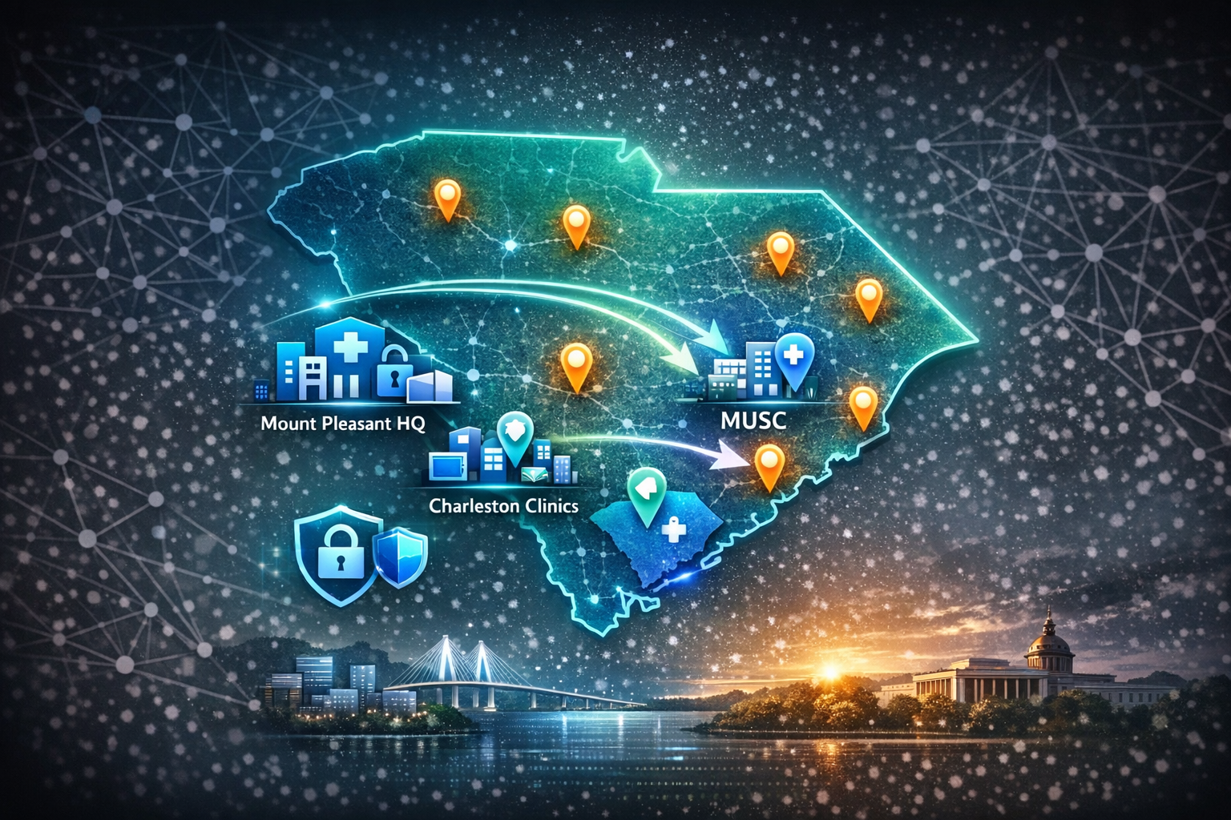
Go-to-market & South Carolina impact
Phase 1: SC-First rollout (Mount Pleasant HQ → MUSC/Charleston Clinics → Statewide)
Partnerships: Seeking pilots with SC medical facilities
Economic Benefit: Jobs, innovation in SC healthcare, local data security.
National scale post-validation.

Slide 10
Competition & differentiation
Centralized EHR Giants (Non-Crypto/Traditional)
Epic Systems (~35-48% US hospital market share, dominant in large systems)
Oracle Cerner/Health (~22-25% share, strong in mid-size/government)
These companies control most EHRs but suffer from silos, high costs, limited patient control, interoperability issues, and vendor lock-in.
Blockchain/Decentralized Projects (Crypto/Alternative)
MedRec (MIT research): Early patient-mediated EHR on Ethereum, focused on permissions but limited scalability/speed.
FHIRChain: FHIR-standard integration with blockchain for interoperability, but often Ethereum-based (higher fees/slower).
BurstIQ/Patientory/Guardtime: Secure data exchange/sharing platforms, HIPAA-focused, but often permissioned/enterprise-heavy without XRPL's speed/low-cost public chain.
Others (e.g., Chronicled MedLedger, Avaneer Health): Supply chain/clinical trials focus; some patient data tools but less emphasis on full sovereignty + real-time integrity on a fast ledger.

Slide 11
Competition & differentiation (cont.)
Our Edge (Why Solus Protocol is Better)
XRPL Foundation: 3-5 second finality + sub-cent fees (vs. Ethereum's higher gas/slower confirmation) for seamless, affordable real-time data sharing/pilots. Energy-efficient/carbon-neutral (no PoW waste). Proven 10+ years zero-downtime scalability.
True Patient Sovereignty: Decentralized, patient-controlled access/ownership (tamper-proof, privacy-preserving) vs. centralized vendor lock-in or partial consent models in competitors.
SC-First, Real-World Entry: Mount Pleasant HQ + MUSC (2.4M patients)/local clinics pilots for quick validation, economic impact, and state ecosystem leverage—faster path to traction than global/general blockchain projects.
Defensibility & Utility: Novel protocol for medical data integrity on XRPL + enterprise SDKs; open-source (Apache 2.0) for adoption while retaining control over extensions/IP strategy. Focus on secure, verifiable records vs. supply-chain-only or trial-focused rivals.
Positioning: High decentralization + high security + patient-first + low-cost/scalable

Slide 12
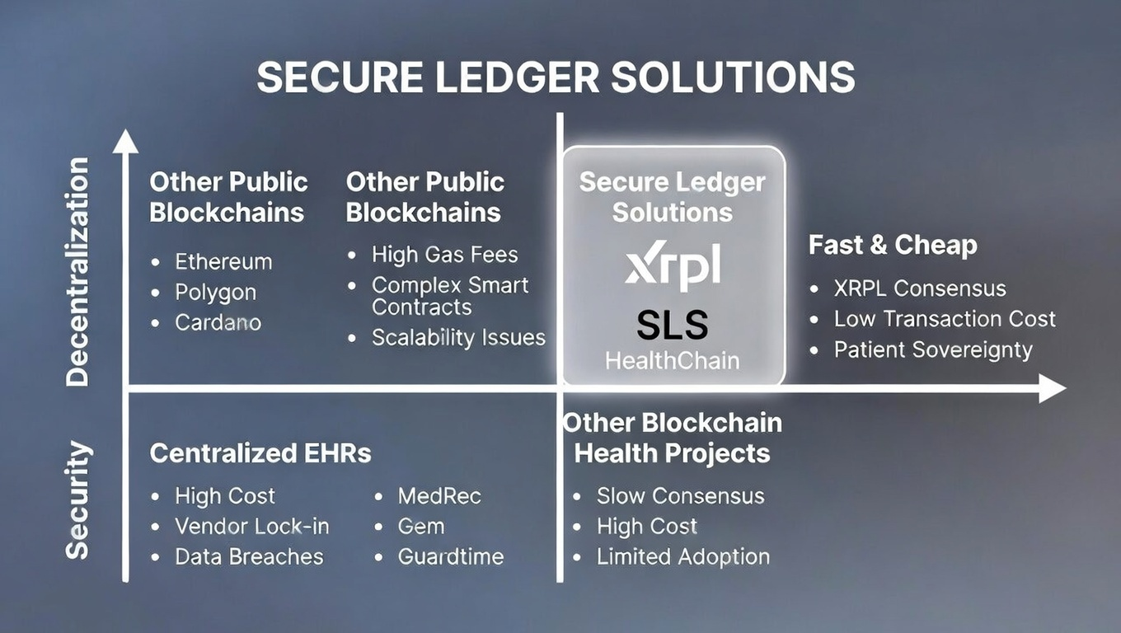
Competition & differentiation (cont.)

Slide 13
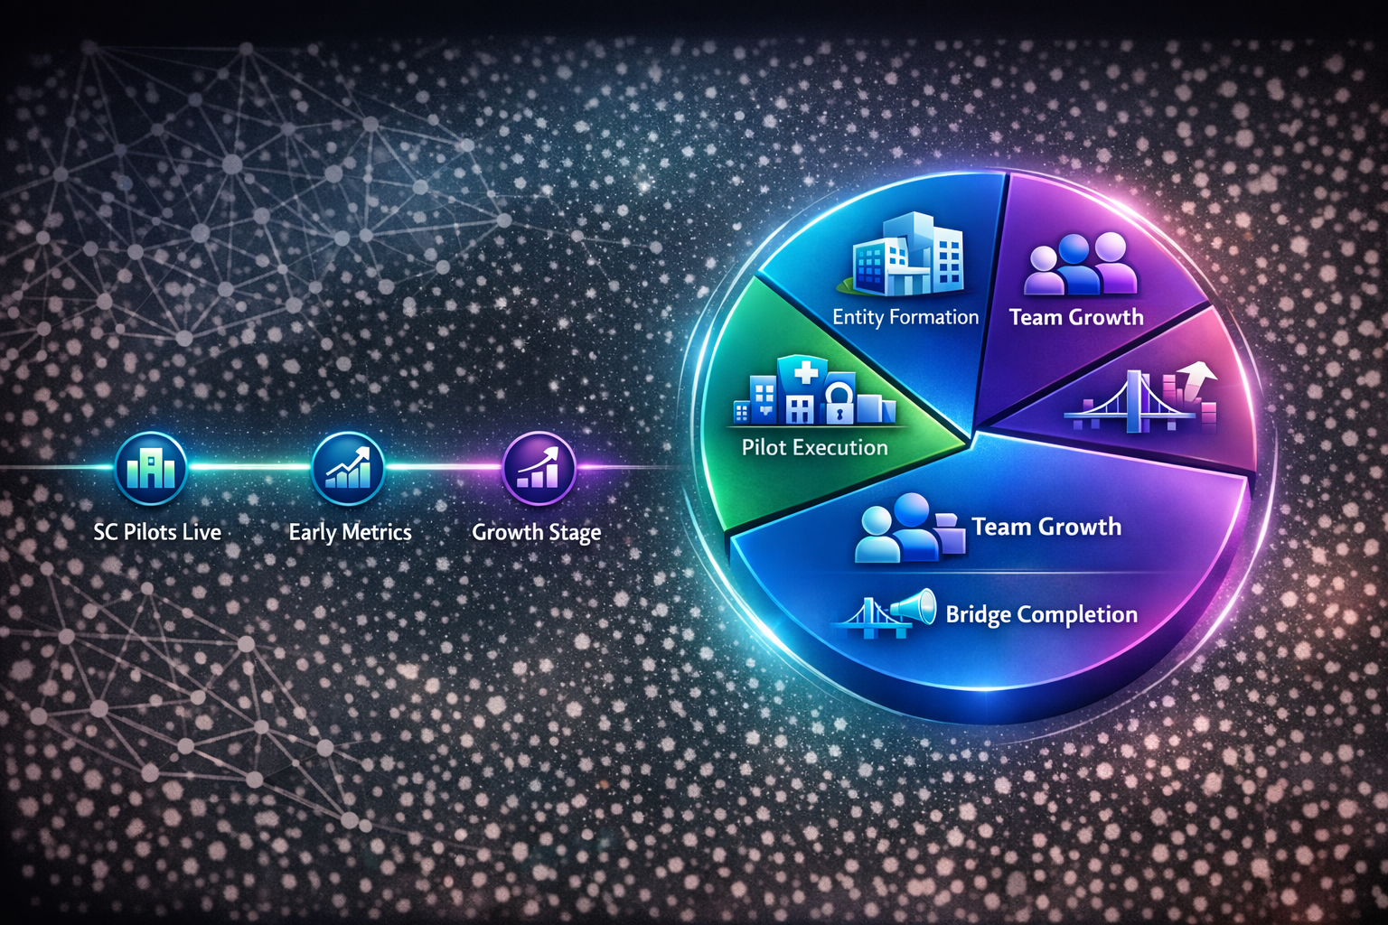
Ask & use of funds
The Ask:
Seeking SCRA Membership → Unlock non-dilutive grants (e.g., Acceleration for validation, Demonstration for pilots) and ecosystem support.
Use of Funds/Support:
Entity Formation (SC LLC or Delaware C-Corp registered in SC)
Pilot Execution (MUSC/Charleston-area clinics + local facilities onboarding)
Team Growth (add advisors/engineers via SCRA network)
Bridge Completion (Axelar XRPL-EVM integration + SDK hardening)
Early Marketing/Validation (SC healthcare partnerships, metrics tracking)
Milestones with SCRA Support:
Q2-Q4 2026: SC entity formed + initial MUSC/clinic pilots live
Q2 2027: Early traction metrics (pilot users, data integrity proofs, on-chain activity)
Q4 2027+: Statewide expansion + national scaling pathway

Slide 14
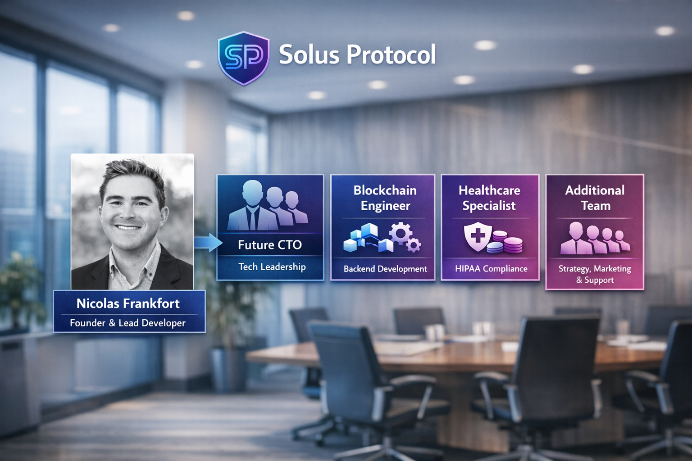
Solus Protocol Team

Slide 15

Thank you
Nicolas Frankfort
Founder & Lead Developer
support@solusprotocol.com
252-268-0547

